Slide 1
Design Thinking: Simplified
A web-tutorial for any UX designer made by A UX designer
Janelle chandass

Slide 2
PROBLEM
People with little or no UX design experience:
Find aspects of the design thinking process ambiguous. There is not always clear understanding of what comes next, which tools or techniques and when
Struggle with the development of some graphics like user flows
Think the process is time consuming, they often need to do a lot of research to find information on best practice or how to create a type of graphic
Have problems coming up with ideas
Other tutorials have large volumes of material, come with considerable time or monetary investment

Slide 3
“I feel overwhelmed by the process. I find it tedious and I have trouble generating ideas this way”, Graham, Year 1 Digital Design Student

Slide 4
To help UX designers to work efficiently and create engaging and user-centred digital products.
Vision statement

Slide 5
SOLUTION
Develop an easy-to-use tutorial website with the following features
Clear and simple language
Clean and minimalist design
Simple navigation to stages or techniques
Utilises multiple media types for displaying examples of tools and techniques, their application and steps on how to create them: step-by-step text instructions, images, (as an additional feature video walkthroughs can be added thereby facilitating different learning styles)

Slide 6
SOLUTION
Develop an easy-to-use tutorial website with the following features
Show stages of the design thinking process and provide links to each stage
Provide user with examples of various UX design techniques and tools to be used at each stage as well as rationale for their use, so the user can decide which is best suited to their needs.
Explain how various graphics should be developed, step-by-step, example how to create a good user story or POV
Gives the user the option to access more detail on each technique or tool, if they so desire
Provide a contact form for users who wish to contribute, request tutorials on a particular topic or provide general feedback

Slide 7
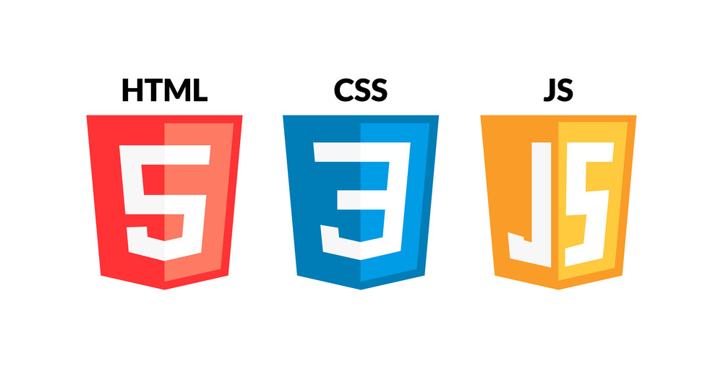
TECH STACK

Slide 8

THE DESIGNER
A recent student herself, Janelle had wanted a one-stop shop for her UX design information and clear guidelines on how to bring it all together. Having navigated several projects and years of teaching experience, she is well equipped to create engaging and useful content.

Slide 9
TARGET MARKET
Anyone interested in learning about UX design or doing UX design for a project, particularly:
UX design students
Developers with little experience in UX design
Novice UX designers
UX designers looking for a different perspective

Slide 10
COMPETITION
Competitor Websites | Pros | Cons
HECMontrealX: UX Design | edX | Self-paced Well established program by recognised institute Accredited program option | Long duration Large volume of material some of which may be inapplicable to user Considerable time investment
Digital Skills: User Experience - Online Course - FutureLearn | Low time investment Free | Less material Lots of videos, which may not work for all learners
UX Tutorial 1: What Exactly Is UX Design? (Free Course) (careerfoundry.com) | Well established program by recognised institute Good content, has career suggestions, as well as detailed explanations linked to main page Construction of some UX diagrams are described in detail | To learn more, user has to go to separate page In some instances, there is a lot of text where a diagram or example would be more helpful, too much detail for user to sort through

Slide 11
WHAT MAKES THIS WEB-TUTORIAL DIFFERENT?
Driven by data from UX design students and novice designers and tested by them
Content created by an educator with years of experience in lesson planning, creation and delivery
Clean, simple design

Slide 12
THANK YOU
Janelle Chandass
jchandass@northislandcollege.ca

